Slide 1
TECHNICAL MECHANICS
MUGWE JOHN NJOROGE
E022-01-2374/2023

Slide 2
ANALYSIS OF A BEAM WITH AN INCLINED LOAD
In the design of structures for buildings or machine members, several challenges can be addressed or enhanced by coding
Structural designs often involve iterative processes, especially when dealing with complex geometries or load variations. Coding allows for rapid iteration and analysis, enabling engineers to explore numerous design options efficiently
By using coding and computational tools, engineers can address these challenges effectively, leading to more robust, efficient, and cost-effective designs in the realm of steel structures.

Slide 3
In this problem the user could either determine sections of the elements of structures, such as trusses, columns and beams etc
Selection procedure: for every element of structure included into design model the program determines the cross-section with min area; the cross-section should take loads defined in design model. To reduce the number of selected cross-sections, elements of design model may be either united into structural elements or unified.

Slide 4
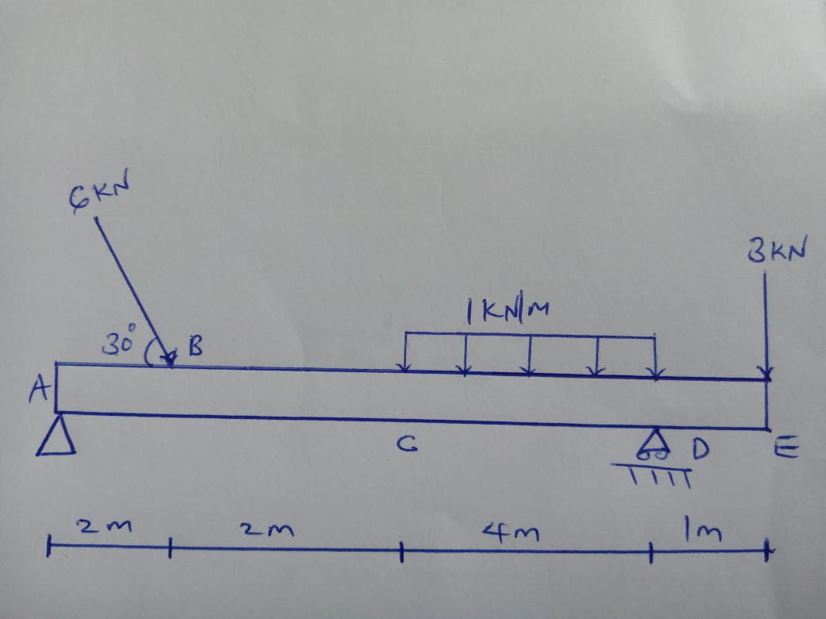
Beam Problem

Slide 5
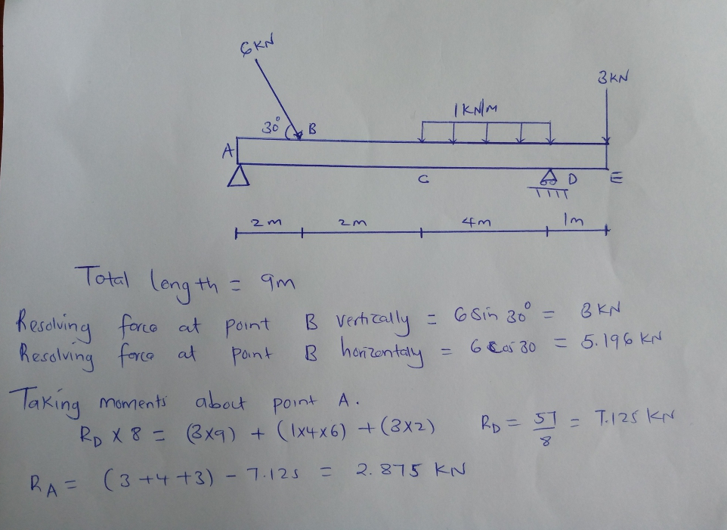
Calculations for Reaction Forces

Slide 6
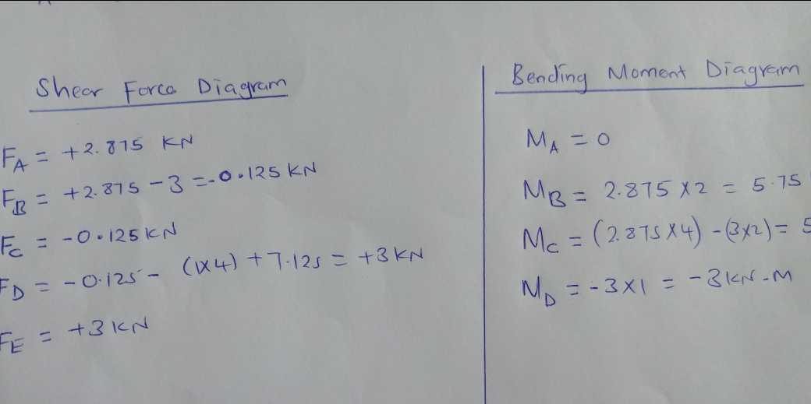
Calculations for Shear Forces and Bending Moments

Slide 7
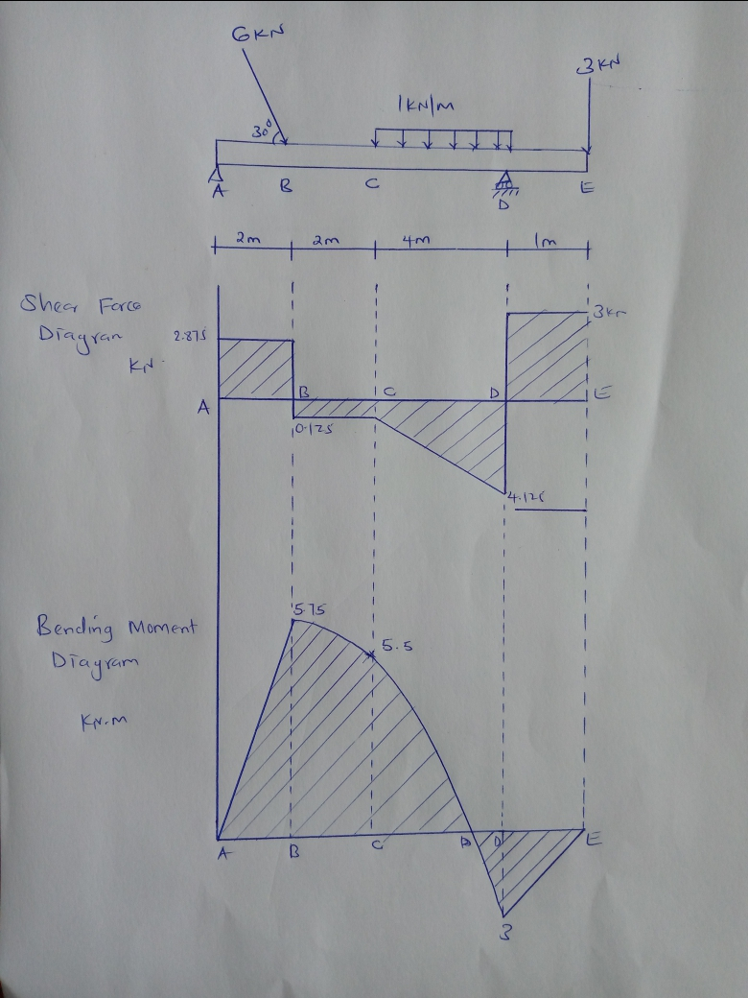
SFD AND BMD FROM CODE

Slide 8
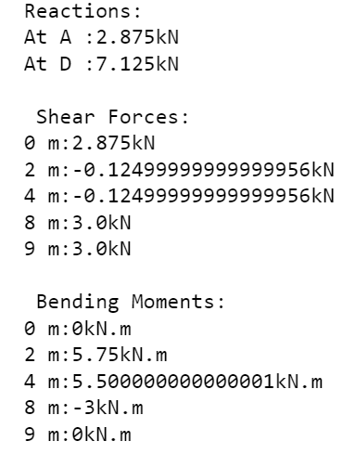
OUTPUT DATA FROM CODE

Slide 9
